Slide 1

ANNOUNCEMENTS

Slide 2



Slide 3


Slide 4



Slide 5
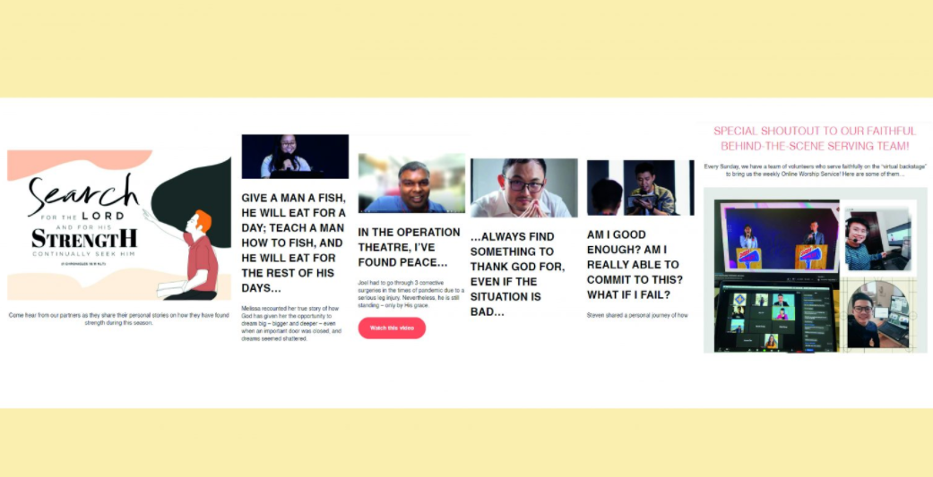
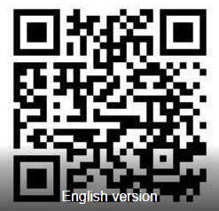

Slide 6


